Slide 1


IPL Cricket Analysis And Prediction Using Machine Learning
Under the Guidance of
A.Radhika, Assistant Professor
Department of Information Technology
B V Raju Institute of Technology, Narsapur
Presented by
D.Swetha (19211A1225)
A.Akshaya (19211A1209)
MD.Farheen (19211A1231)
Batch No:-11

Slide 2
Abstract
Abstract
Introduction
Existing System
Disadvantages
Proposed System
Advantages
Software Requirements
& Hardware Requirements
Abstract Introduction Existing System Proposed System
Software & Hardware Requirements Architecture Model
Modules
UML Diagrams References
Methodology
UML Diagrams
Screen shots
Future Enhancement
Conclusion
References
In today’s date data analysis is needed for every data analyzer to examine the sets of data to extract the useful information from it and to draw conclusions according to the information.
In recent years the analytics is being used in the field of sports to predict and draw various insights.
Due to the involvement of money, team spirit, city loyalty and a massive fan following, the outcome of matches is very important for all stake holders. This, in turn, is dependent on the complex rules governing the game, luck of the team (Toss),the ability of players and their performances on a given day.Various other natural parameters, such as the historical data related to players, play an integral role in predicting the outcome of a cricket match.
This Project aims to provide the statistical analysis of players based on different characteristics . To predict the performance of a team depending on individual player statistics. To successfully predict the outcome of IPL matches.

Slide 3
Abstract
Introduction
Existing System
Disadvantages
Proposed System
Advantages
Software Requirements
& Hardware Requirements
Methodology
UML Diagrams
Screen shots
Future Enhancement
Conclusion
References
Introduction
Cricket is a bat-and-ball game played between two teams of eleven players each on a cricket field, at the center of which is a rectangular 20-metre (22-yard) pitch with a target at each end called the wicket (a set of three wooden stumps upon which two bails sit).
Each phase of play is called an innings, during which one team bats, attempting to score as many runs as possible, while their opponents bowl and field, attempting to minimize the number of runs scored.
When each innings ends, the teams usually swap roles for the next innings (i.e. the team that previously batted will bowl/field, and vice versa).
The teams each bat for one or two innings, depending on the type of match. The winning team is the one that scores the most runs, including any extras gained (except when the result is not a win/loss result)
All Indian Premier League Cricket matches between 2008 and 2016.

Slide 4
Existing System
Abstract
Introduction
Existing System
Disadvantages
Proposed System
Advantages
Software Requirements
& Hardware Requirements
Methodology
UML Diagrams
Screen shots
Future Enhancement
Conclusion
References
Existing system purely depends on how the team deals with the very important factors that influence the outcome.
For classification problems like predicting the outcome of matches or classifying player algorithms like Naive Bayes, Neural Networks are used.

Slide 5
Disadvantages of Existing System
Abstract
Introduction
Existing System
Disadvantages
Proposed System
Advantages
Software Requirements
& Hardware Requirements
Methodology
UML Diagrams
Screen shots
Future Enhancement
Conclusion
References
By using these algorithms in this prediction we can’t determine the accurate value of the output provided by the statistics.

Slide 6
Abstract
Introduction
Existing System
Disadvantages
Proposed System
Advantages
Software Requirements
& Hardware Requirements
Methodology
UML Diagrams
Screen shots
Future Enhancement
Conclusion
References
Proposed System
In our system we aimed to prioritize the important factors which influence the match by giving them the balanced strength using intelligent formulas like Eulers Strength calculation formula. We researched on beauty behind T20 cricket which is very sensitive as even one over can change the match and hence by showing the importance of Machine Learning in the prediction by giving the support or the confidence to the Winner that is predicted.
For in-depth predicting continuous values, Linear Regression can be quite effective, and for classification problems like predicting the outcome of matches or classifying player algorithms like Naive Bayes, Logistic Regression, Neural Networks, Random Forests can appear to be quite affective..

Slide 7
Abstract
Introduction
Existing System
Disadvantages
Proposed System
Advantages
Software Requirements
& Hardware Requirements
Methodology
UML Diagrams
Screen shots
Future Enhancement
Conclusion
References
Advantages of Proposed System
Easy to calculate all players tasks.
By using the algorithms which are in the proposed system we can determine the accurate value of the output.
By these prediction we can easily identify which team will win the IPL match.

Slide 8
Abstract
Introduction
Existing System
Disadvantages
Proposed System
Advantages
Software Requirements
& Hardware Requirements
Methodology
UML Diagrams
Screen shots
Future Enhancement
Conclusion
References
Software & Hardware Requirements
Software Requirements:
Language : Python ,HTML and CSS
Operating System : Windows 10 or 11
IDE : Google colab ,Flask Framework
Source : Github
Hardware Requirements:
Ram : 4 GB.
Processor : Core i3 Processor based computer.
Hard Disk : 40 GB RAM.
Input Devices : Mic, Keyboard, Mouse.

Slide 9
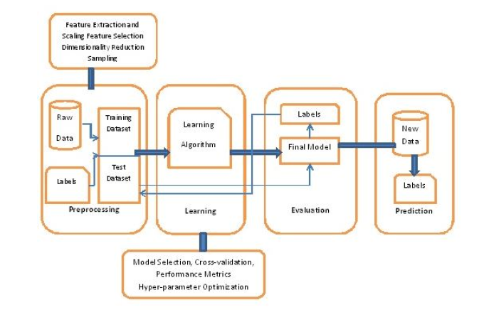
Methodology
Abstract
Introduction
Existing System
Disadvantages
Proposed System
Advantages
Software Requirements
& Hardware Requirements
Methodology
UML Diagrams
Screen shots
Future Enhancement
Conclusion
References
Introduction
Existing System Proposed System
Software Requirements
References

Slide 10
Methodology
Abstract
Introduction
Existing System
Disadvantages
Proposed System
Advantages
Software Requirements
& Hardware Requirements
Methodology
UML Diagrams
Screen shots
Conclusion
Future Enhancement
References
Introduction
Existing System Proposed System
Software Requirements
References
The methodology consists of 4 main stages- Data Preprocessing, Data Cleansing, Data Preparation, Encoding the data. Initially, the seven IPL seasons real-time dataset is taken in CSV(comma-separated values) format.
In data preprocessing phase, the data is incomplete, noisy and inconsistent. Data is to be filled with missing values and correct the inconsistencies.
In data cleansing phase, data validation is done by maintaining consistency across the dataset and data enhancement is done by adding related information to the dataset.
The data preparation is significant for achieving optimal results. This involves choosing an outcome measure to evaluate different predictor variables.

Slide 11
Methodology
Abstract
Introduction
Existing System
Disadvantages
Proposed System
Advantages
Software Requirements
& Hardware Requirements
Methodology
UML Diagrams
Screen shots
Future Enhancement
Conclusion
References
In data Encoding phase, label each term with short names and encode them as numerical values for predictive modeling as implemented below.
The test dataset is taken as input to the learning algorithm, evaluates different scenarios like toss winner, toss decision and team winner. Thus, new data is obtained with final prediction.

Slide 12
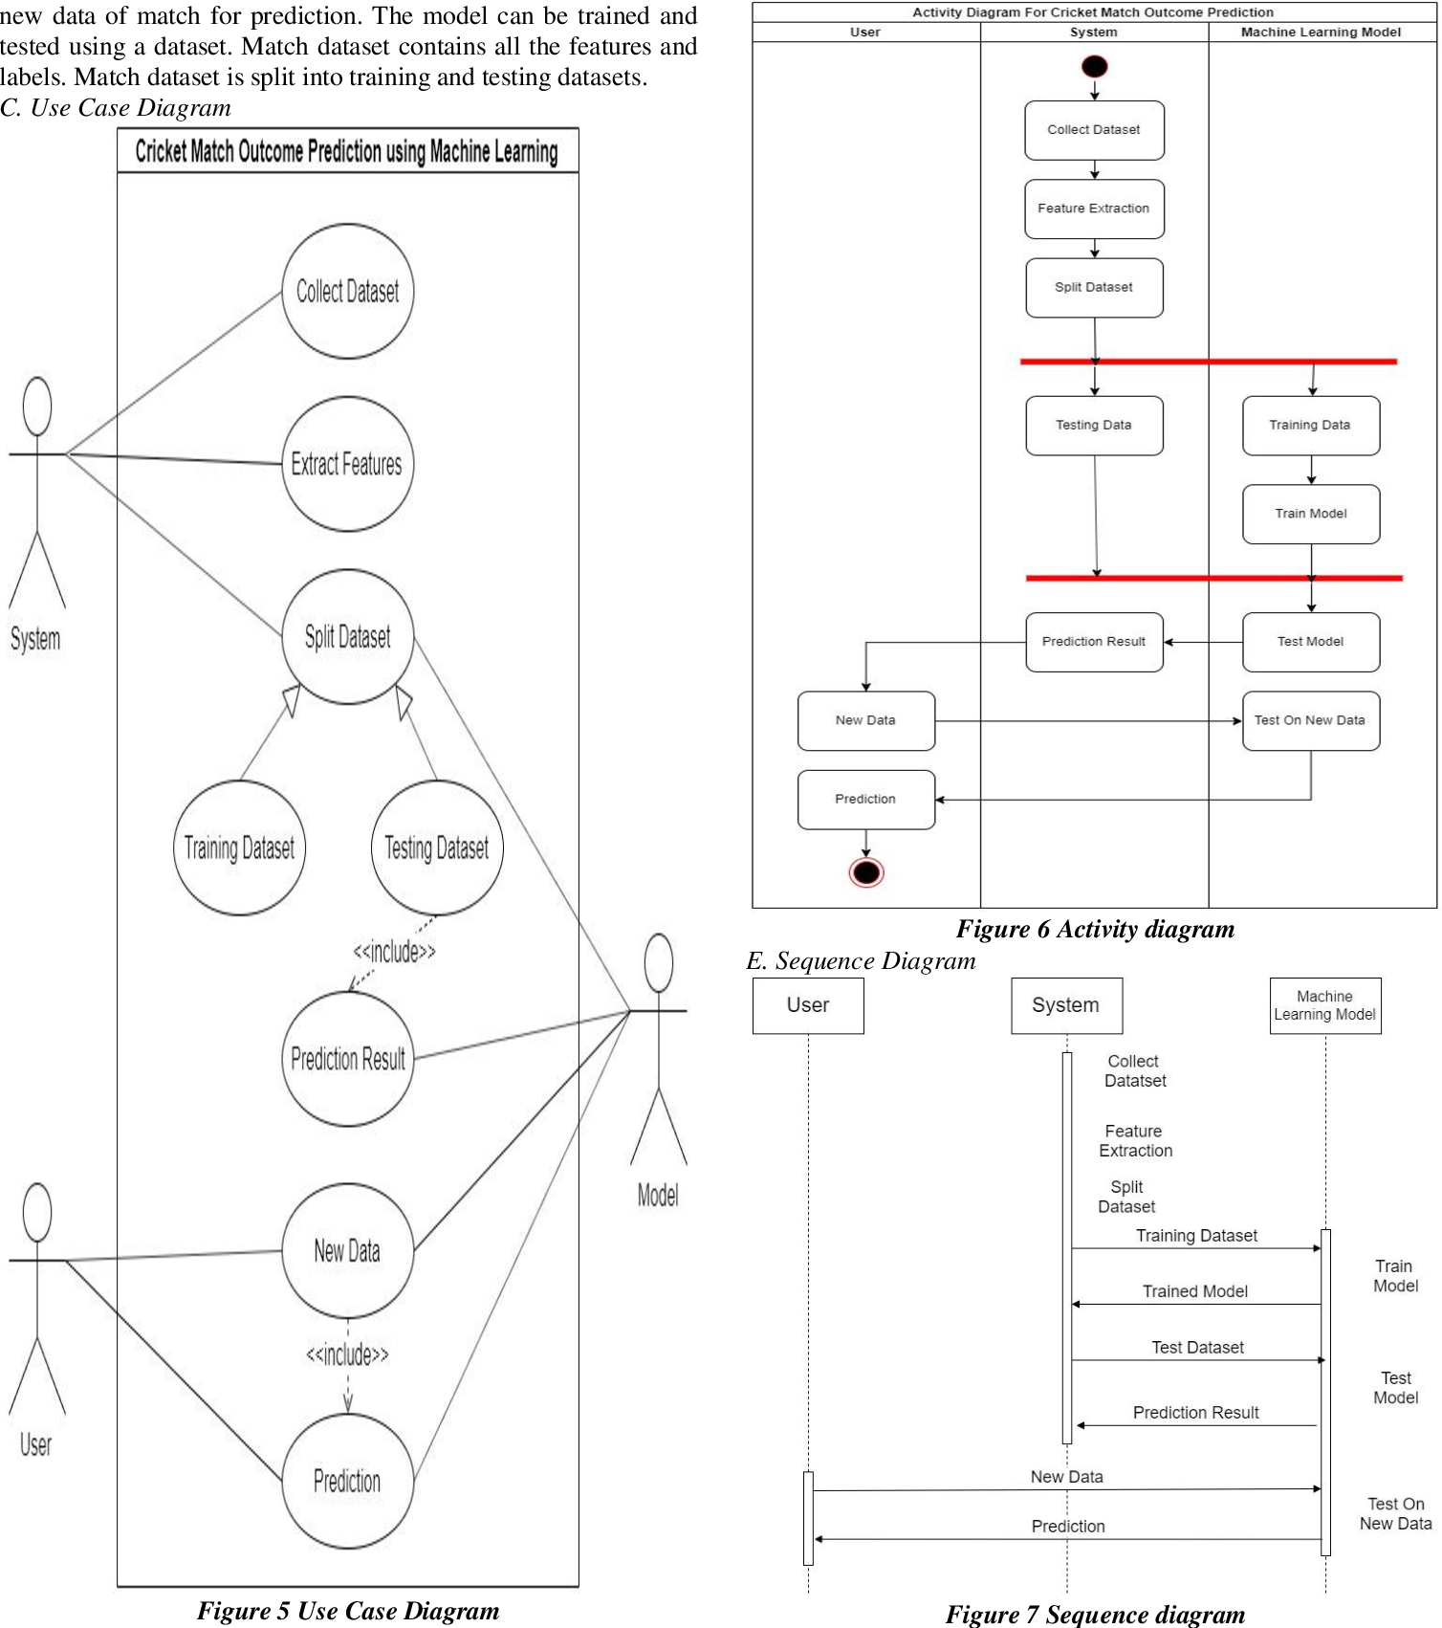
UML Diagrams
Abstract
Introduction
Existing System
Disadvantages
Proposed System
Advantages
Software Requirements
& Hardware Requirements
Methodology
UML Diagrams
Screen shots
Future Enhancement
Conclusion
References
Introduction
Existing System Proposed System
Software Requirements
References
USE CASE Diagram:

Slide 13
UML Diagrams
Abstract
Introduction
Existing System
Disadvantages
Proposed System
Advantages
Software Requirements
& Hardware Requirements
Methodology
UML Diagrams
Screen shots
Future Enhancement
Conclusion
References
Introduction
Existing System Proposed System
Software Requirements
References
Sequence Diagram:

Slide 14
UML Diagrams
Abstract
Introduction
Existing System
Disadvantages
Proposed System
Advantages
Software Requirements
& Hardware Requirements
Methodology
UML Diagrams
Screen shots
Future Enhancement
Conclusion
References
Introduction
Existing System Proposed System
Software Requirements
References
Activity Diagram:

Slide 15
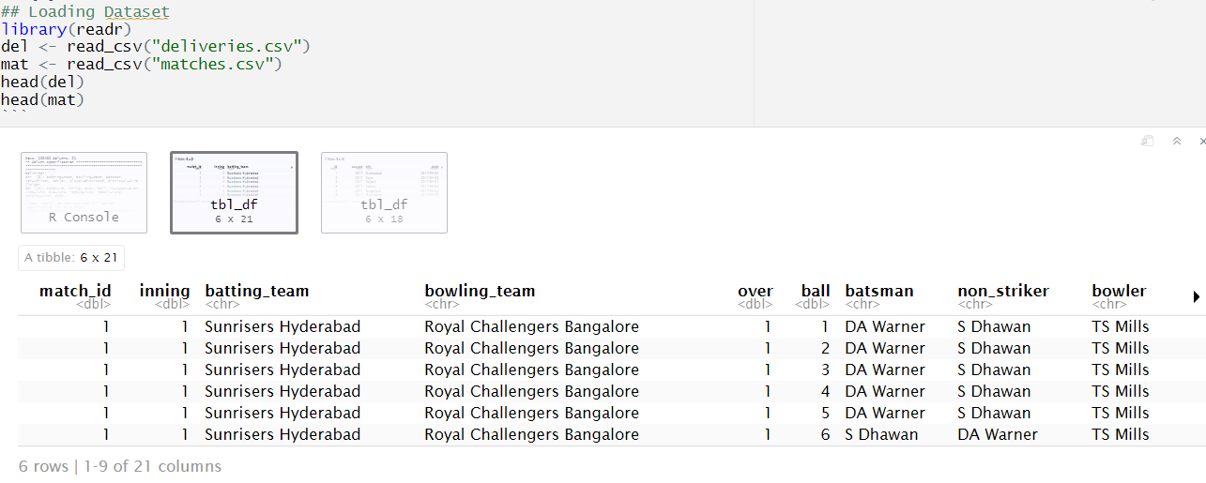
Screenshots
Abstract
Introduction
Existing System
Disadvantages
Proposed System
Advantages
Software Requirements
& Hardware Requirements
Methodology
UML Diagrams
Screen shots
Future Enhancement
Conclusion
References
Introduction
Existing System Proposed System
Software Requirements
References
The dataset is loaded into the R Software using the function read.csv() and pre-processing is done. It works based on extracting best features by comparing original attribute’s importance. It eliminates all irrelevant features to stabilize the performance of the test. Below is the delivery Dataset

Slide 16
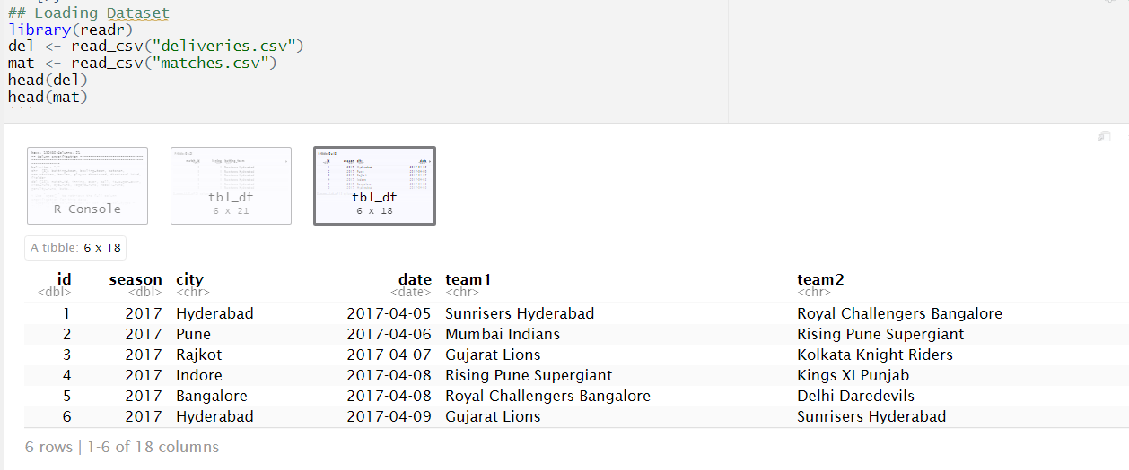
Screenshots
Abstract
Introduction
Existing System
Disadvantages
Proposed System
Advantages
Software Requirements
& Hardware Requirements
Methodology
UML Diagrams
Screen shots
Future Enhancement
Conclusion
References
Introduction
Existing System Proposed System
Software Requirements
References
Matches Dataset

Slide 17
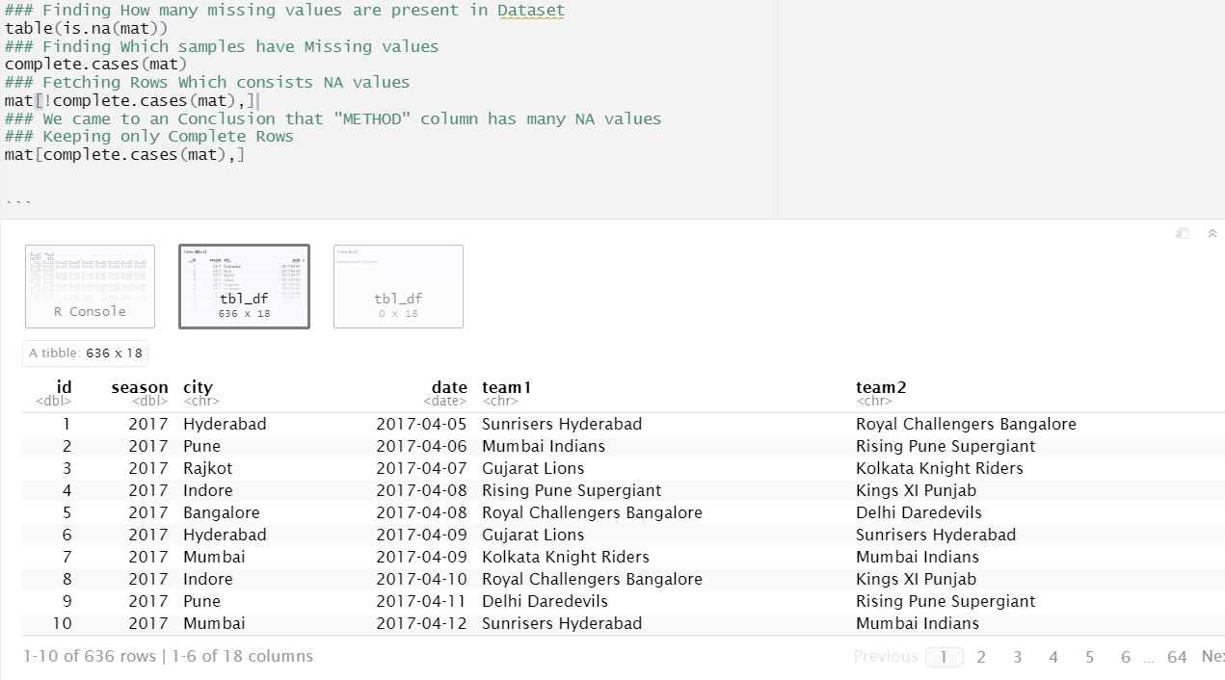
Screenshots
Abstract
Introduction
Existing System
Disadvantages
Proposed System
Advantages
Software Requirements
& Hardware Requirements
Methodology
UML Diagrams
Screen shots
Future Enhancement
Conclusion
References
Introduction
Existing System Proposed System
Software Requirements
References
DATA CLEANING & DATA MANIPULATION
Finding Missing values are present in Dataset
Finding which samples having missing Values
Fetching Rows which consists NA values
## There’s a column name METHOD which consists of many NA values , which is removed

Slide 18
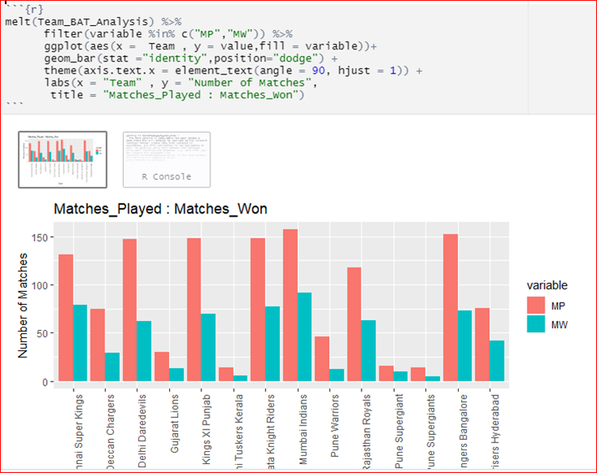
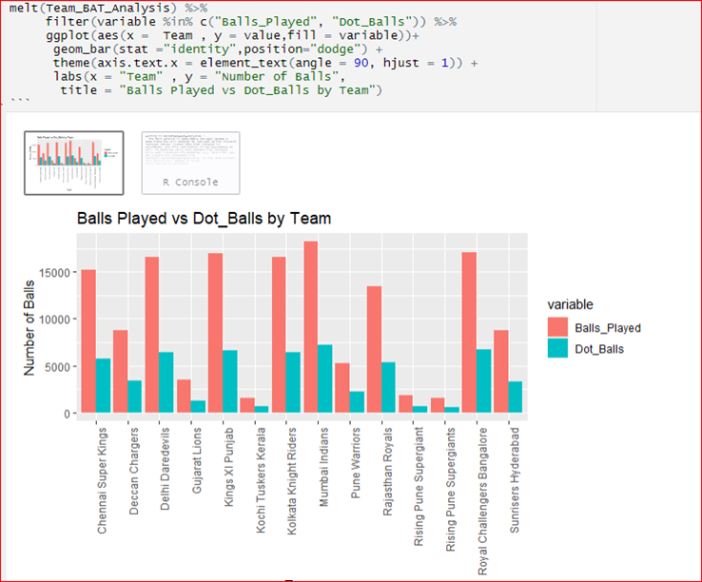
Abstract
Introduction
Existing System
Disadvantages
Proposed System
Advantages
Software Requirements
& Hardware Requirements
Methodology
UML Diagrams
Screen shots
Future Enhancement
Conclusion
References
Screenshots
MATCHES PLAYED vs MATCHES WON
BALLS PLAYED vs DOT BALLS

Slide 19
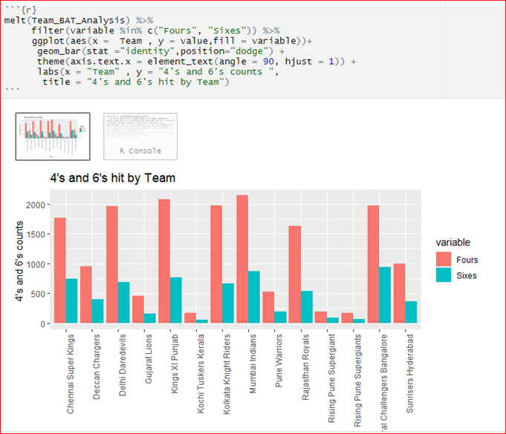
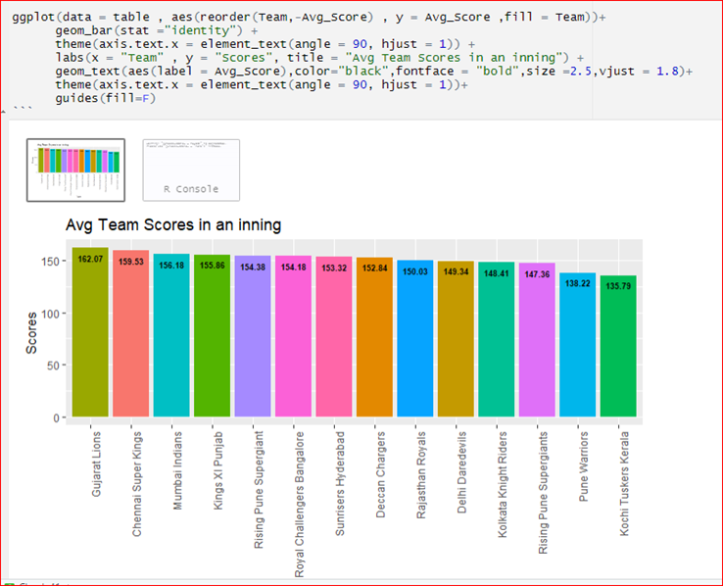
Abstract
Introduction
Existing System
Disadvantages
Proposed System
Advantages
Software Requirements
& Hardware Requirements
Methodology
UML Diagrams
Screen shots
Future Enhancement
Conclusion
References
Screenshots
4’s and 6’s Hit by a Team
Average Team Scores in an Innings

Slide 20
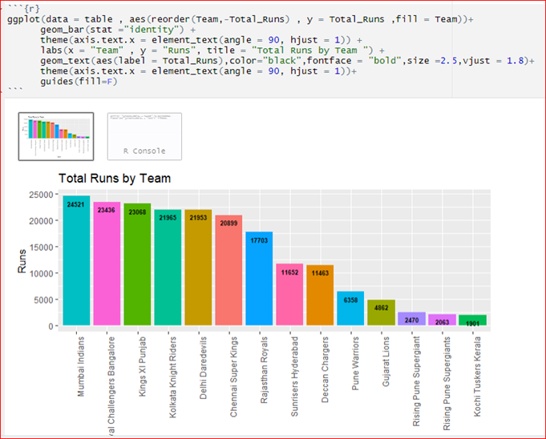
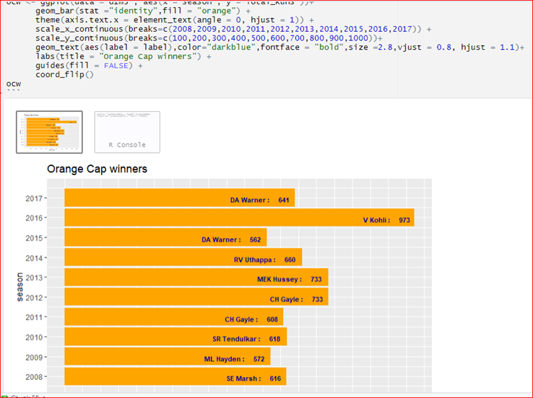
Abstract
Introduction
Existing System
Disadvantages
Proposed System
Advantages
Software Requirements
& Hardware Requirements
Methodology
UML Diagrams
Screen shots
Future Enhancement
Conclusion
References
Screenshots
Orange Cap Winners – (Most Runs Scored in a Season)
Total Runs by a Team

Slide 21
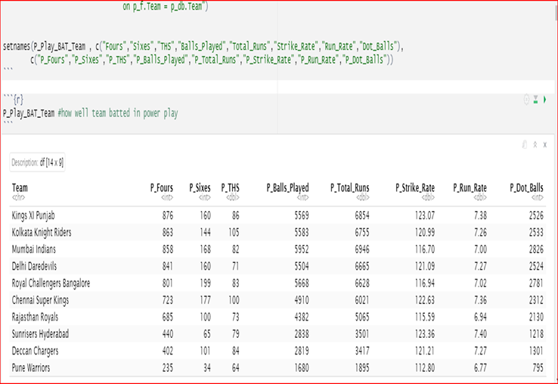
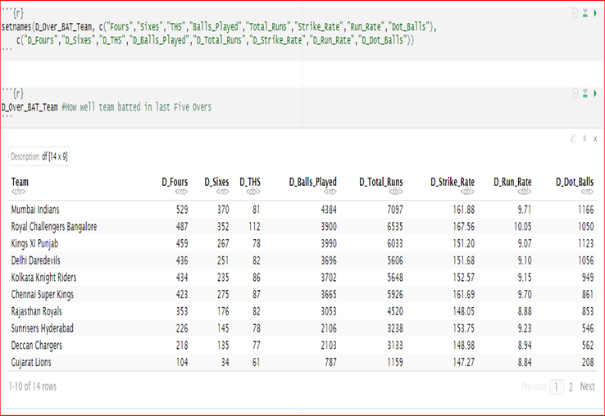
Abstract
Introduction
Existing System
Disadvantages
Proposed System
Advantages
Software Requirements
& Hardware Requirements
Methodology
UML Diagrams
Screen shots
Future Enhancement
Conclusion
References
Screenshots
PowerPlay Analysis (Overs 1-6)
Death Over Analysis (Overs 16-20)

Slide 22
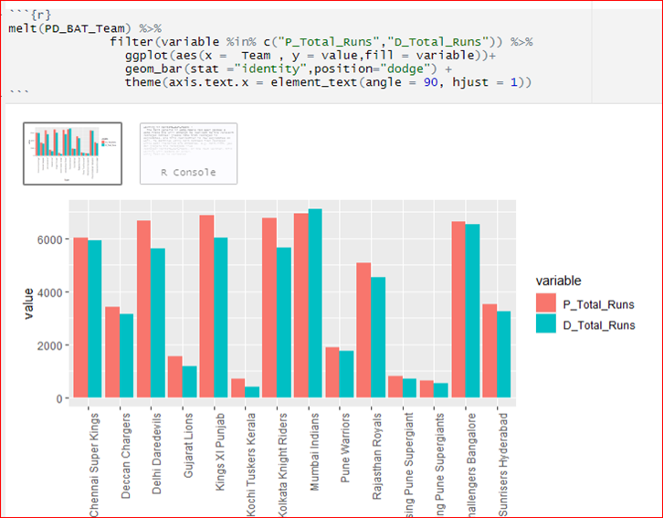
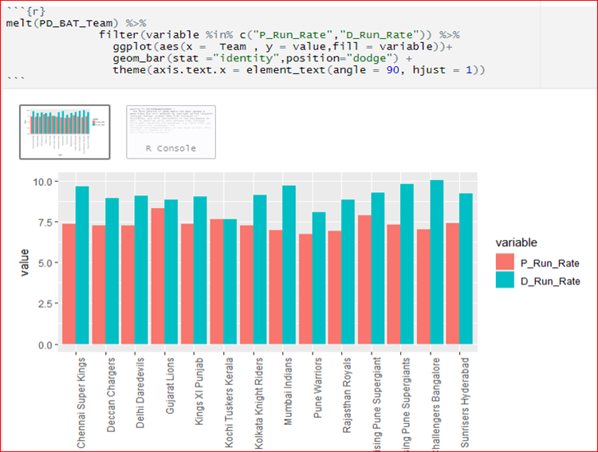
Abstract
Introduction
Existing System
Disadvantages
Proposed System
Advantages
Software Requirements
& Hardware Requirements
Methodology
UML Diagrams
Screen shots
Future Enhancement
Conclusion
References
Screenshots
Power Play Runs vs Death Over Runs
Power Play RunRate vs Death Over RunRate

Slide 23
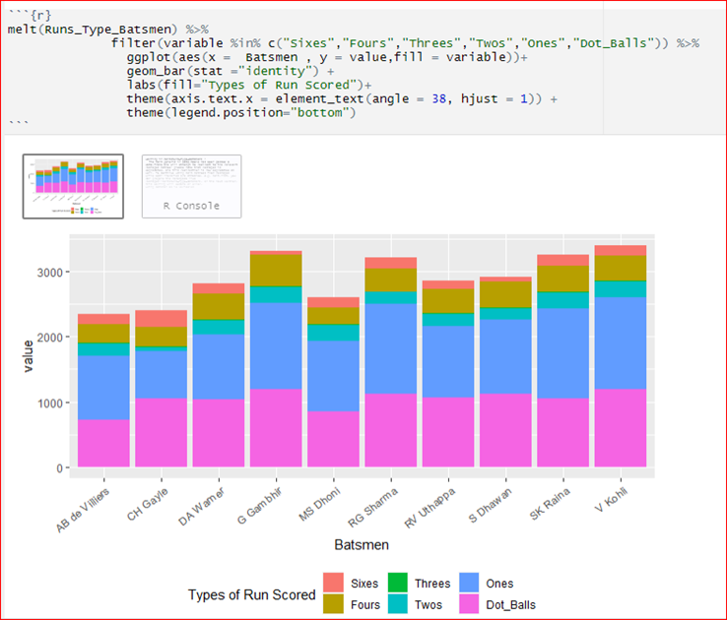
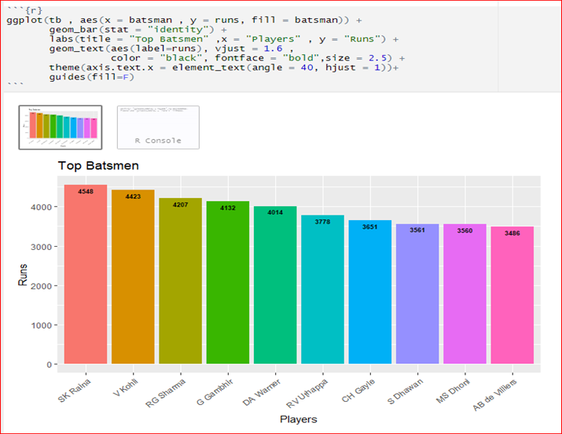
Abstract
Introduction
Existing System
Disadvantages
Proposed System
Advantages
Software Requirements
& Hardware Requirements
Methodology
UML Diagrams
Screen shots
Future Enhancement
Conclusion
References
Screenshots
TOP SCORERS
Types of Runs Scored by Batsman

Slide 24
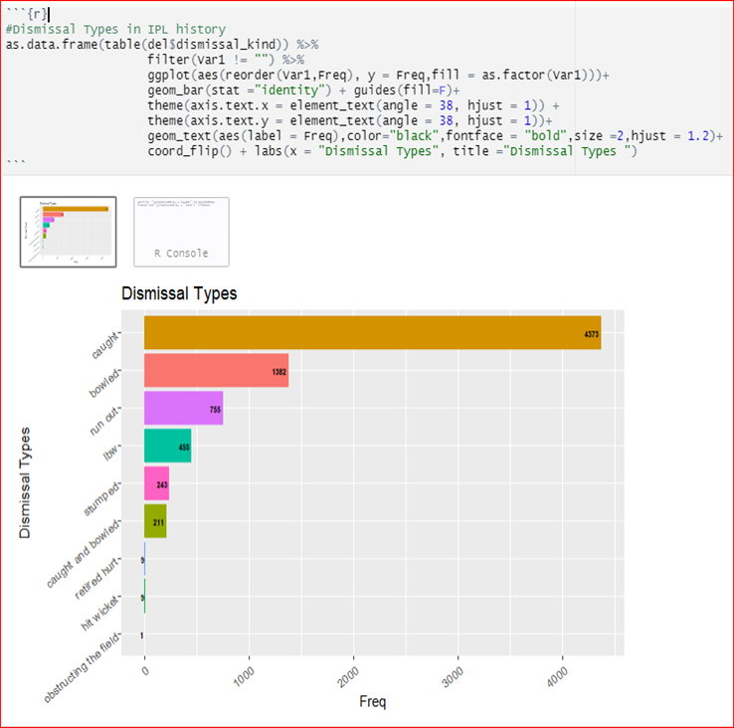
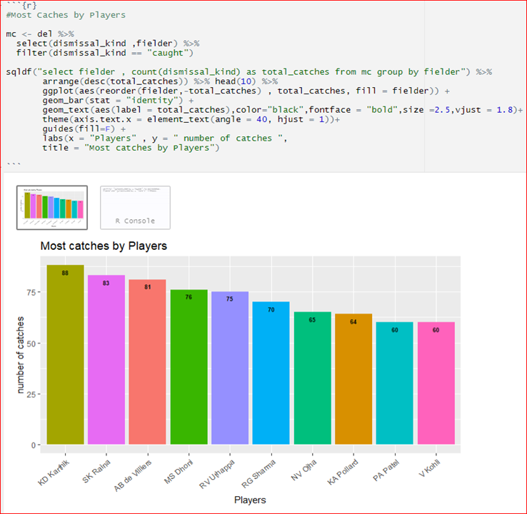
Abstract
Introduction
Existing System
Disadvantages
Proposed System
Advantages
Software Requirements
& Hardware Requirements
Methodology
UML Diagrams
Screen shots
Future Enhancement
Conclusion
References
Screenshots
Dismissal Types in IPL
Most Catches by Players

Slide 25
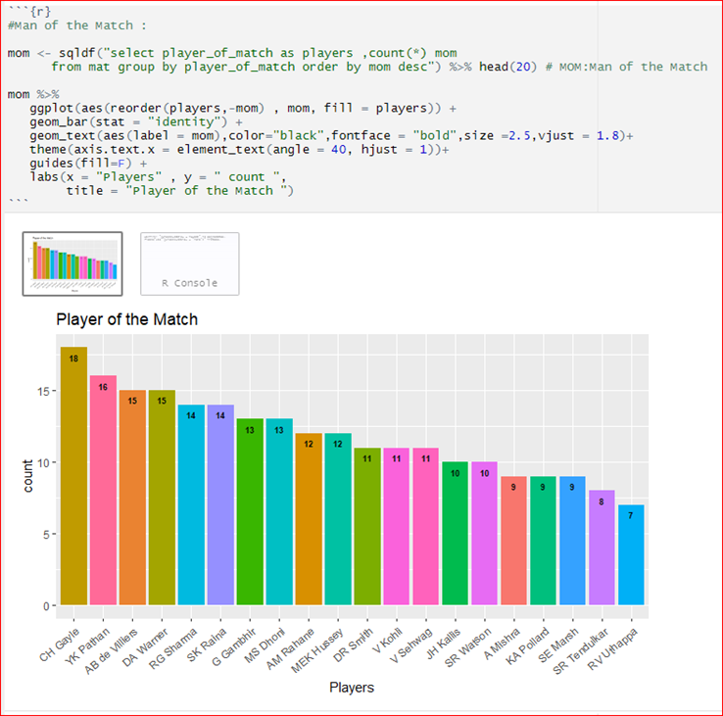
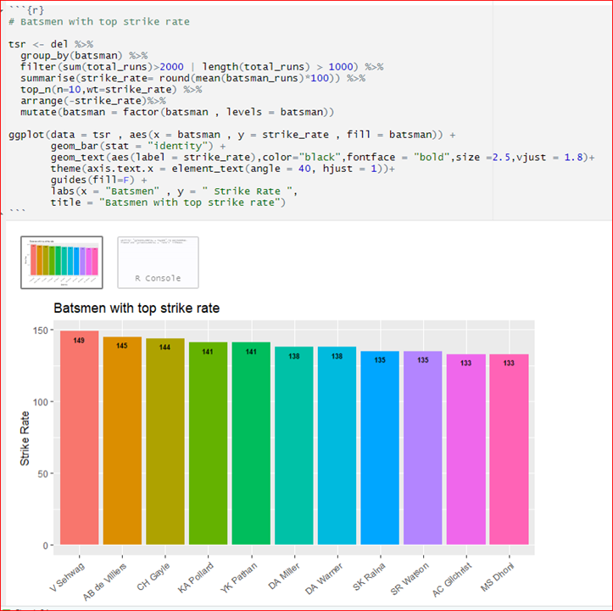
Abstract
Introduction
Existing System
Disadvantages
Proposed System
Advantages
Software Requirements
& Hardware Requirements
Methodology
UML Diagrams
Screen shots
Future Enhancement
Conclusion
References
Screenshots
Most Man of The Matches Award
Batsmen with Top Strike Rate

Slide 26
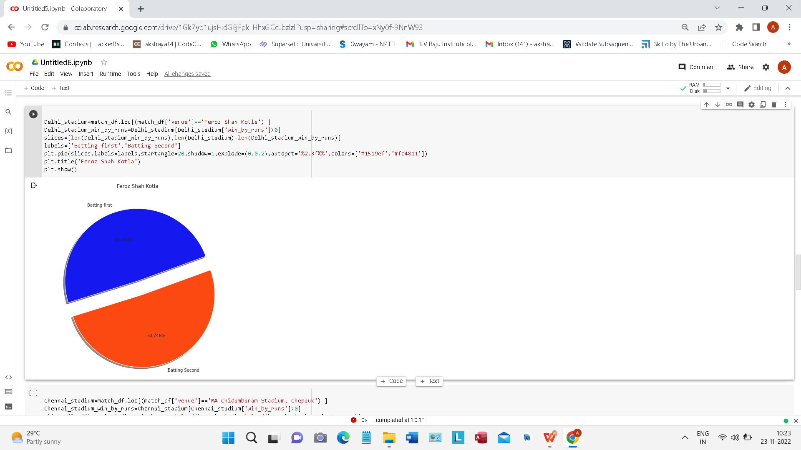
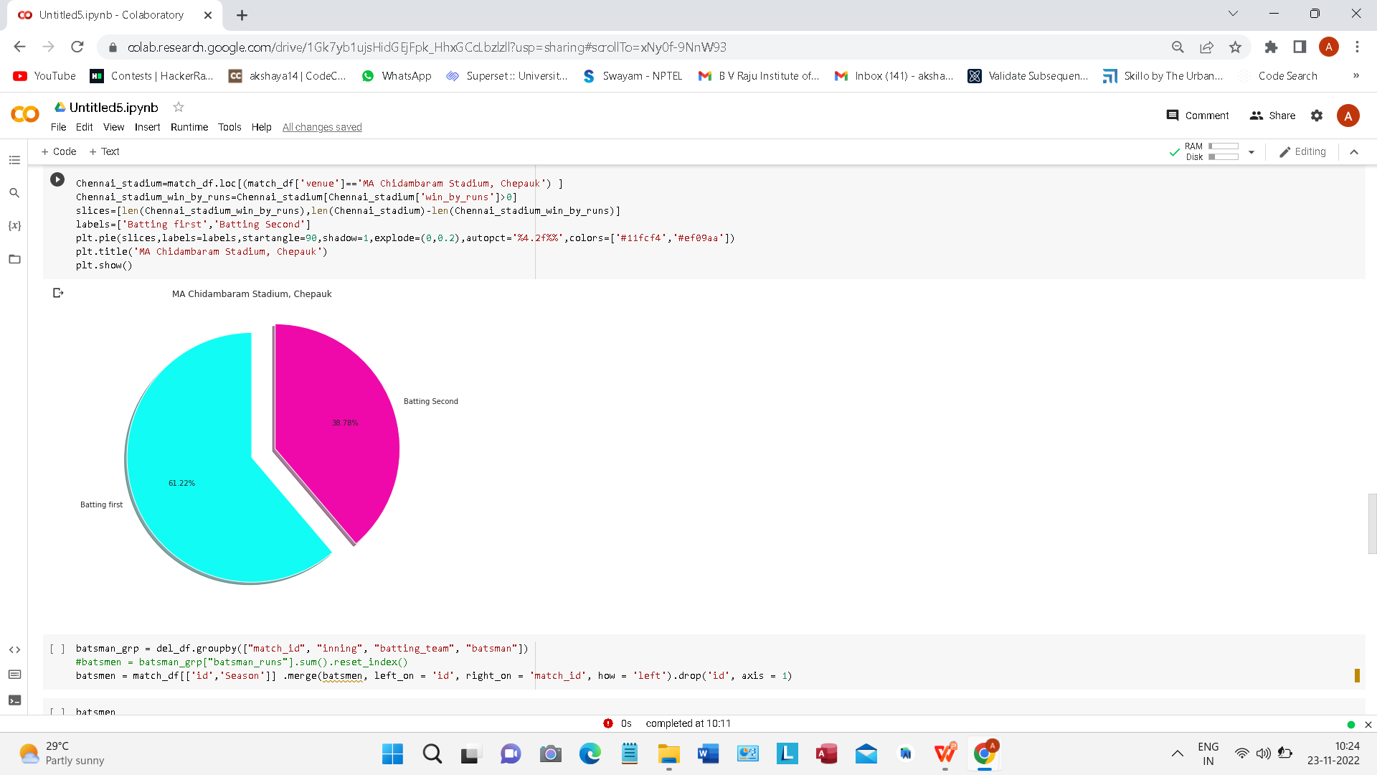
Abstract
Introduction
Existing System
Disadvantages
Proposed System
Advantages
Software Requirements
& Hardware Requirements
Methodology
UML Diagrams
Screen shots
Future Enhancement
Conclusion
References
Screenshots

Slide 27
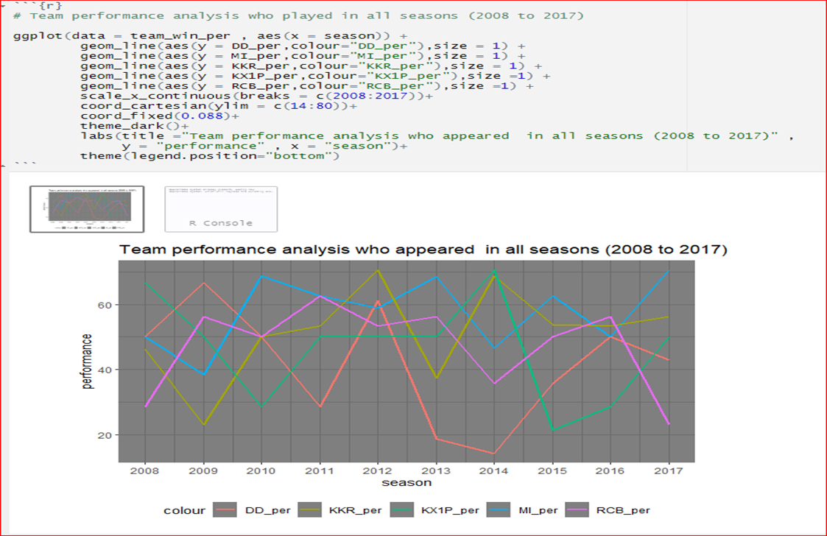
Abstract
Introduction
Existing System
Disadvantages
Proposed System
Advantages
Software Requirements
& Hardware Requirements
Methodology
UML Diagrams
Screen shots
Future Enhancement
Conclusion
References
Screenshots
TEAMS PERFORMANCE WHO APPEARED IN ALL SEASONS

Slide 28
Though it is a fun machine learning project, it can be extended to corporate level also, where Sporting channels would like to show the metrics which can be used to increase the audience pulse, which shows the factors which can change even a losing game inclined to winning. It uses for creating online polls, Sports Business. IPL teams do their own analysis on each and every player as they spend millions on each of them, they use various analysis like Player Vs Ground Battle, before bidding the player.
Methodology
UML Diagrams
Screen shots
Future Enhancement
Conclusion
References
Abstract
Introduction
Existing System
Disadvantages
Proposed System
Advantages
Software Requirements
& Hardware Requirements
Future Enhancement

Slide 29
Methodology
UML Diagrams
Screen shots
Future Enhancement
Conclusion
References
Abstract
Introduction
Existing System
Disadvantages
Proposed System
Advantages
Software Requirements
& Hardware Requirements
Conclusion
This work aims at understanding the dataset of past 10 years history of the IPL data.
Selection of the best team for a cricket match plays a significant role for the team’s victory.
The main goal of this project is to analyze the IPL cricket data and predict the players’ performance. We performed in depth analysis of each and every team. And separately performed power and death over analysis which is very important in T20 cricket , where the most number of runs are scored.We also performed Batting and Bowling Analysis of Different Top Batsmen and Bowlers.
At the end, in-depth analysis was done based on number of runs scored by each team at power-play and death overs correspondingly.
Final Result was performed through Exploratory analysis and our previous observations, we obtained performances of each and every IPL team over the past few years and resulted Ups and Downs of different teams graphically.

Slide 30
References
Abstract
Introduction
Existing System
Disadvantages
Proposed System
Advantages
Software Requirements
& Hardware Requirements
Methodology
UML Diagrams
Screen shots
Future Enhancement
Conclusion
References
Introduction
Existing System Proposed System Software requirements References
Sanjay Gupta, Hitesh Jain, Asmit Gupta and Hemant Soni, “Fantasy League Team Prediction”, International Journal of Research in Science and Engineering, Vol. 6, No. 3, pp. 97-103, 2017.
Rameshwari Lokhande and P.M. Chawan, “Live Cricket Score and Winning Prediction”, International Journal of Trend in Research and Development, Vol. 5, No. 1, pp. 30-32, 2018.
Vignesh Veppur Sankaranarayanan and Junaed Sattar,“Auto-play: A Data Mining Approach to ODI Cricket Simulation and Prediction”, Proceedings of SIAM Conference on Data Mining, pp. 1-7, 2014.
Jayshree Hajgude, Aishwarya Parameshwaran, Krishna Nambi, Anupama Sakhalkar and Darshil Sanghvi, “IPL Dream Team-A Prediction Software Based on Data Mining and Statistical Analysis”, International Journal of Computer Engineering and Applications, Vol. 9, No. 4, pp. 113-119, 2015.

Slide 31
Thank you
Any Questions?

